Slide 1
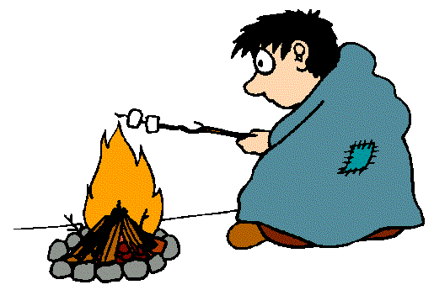
Heat Transfer
http://www.youtube.com/watch?v=ajQ3hm5JidU&safe=active
Heat and Weather video 3:27

Slide 2
The Sun
The source of heat for our planet
Moves through space, then through the earth's atmosphere and finally reaches the earth's surface.
Warms the earth's atmosphere and surface
Is what drives weather and climate.

Slide 3
Three Mechanisms
Heat can be transferred from one place to another by
Conduction,
Convection
Radiation.

Slide 4
Bill Nye Video
http://www.youtube.com/watch?v=f1eAOygDP5s&safe=active
2:06

Slide 5
Conduction
Transfers heat by direct contact
Matter touching matter
Can occur between any state of matter: solid, liquid or gas
Metals are good conductors of heat
Bad conductors include wood, rubber, glass
Example: Heat transfers directly from the element of a stove to a metal pot
http://www.youtube.com/watch?v=wV7gzcKegdU&safe=active Eureka Conduction 2:02

Slide 6
Convection
Heat is transferred by the moving of particles/molecules from one place to another
Hotter particles move further apart and rise
Cooler particles move closer together and fall
Transfer is therefore vertical (up & down)
Only occurs in liquids and gases
Example: Currents are created
http://www.youtube.com/watch?v=ON2Y3FEk_UI&safe=active Eureka Convection 2:06

Slide 7
Radiation
Transfer of thermal energy by the release of a photon from the Electromagnetic Spectrum
Heat is transferred through space
Electromagnetic (EM) waves from the sun can collide with matter of all types
The EM waves are converted to heat when they collide with matter
Darker and denser objects absorb EM waves faster
http://www.youtube.com/watch?v=2JZciWtK6vc&safe=active Eureka Radiation 4:02

Slide 8
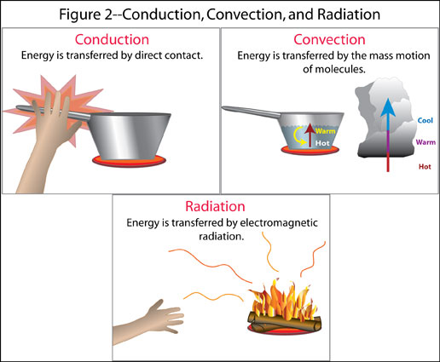

Slide 9
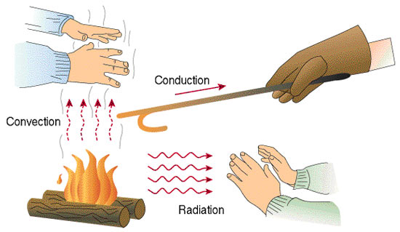
2
1
3

Slide 10
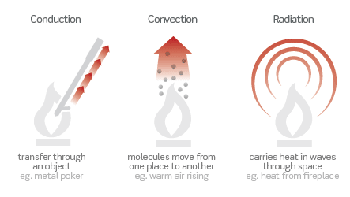

Slide 12
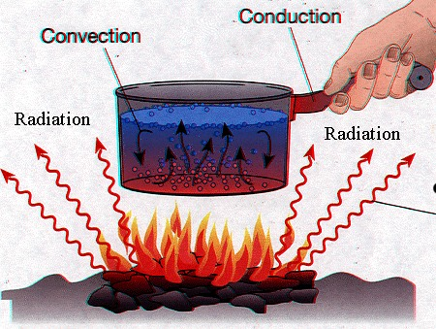
3
2
1

Slide 13
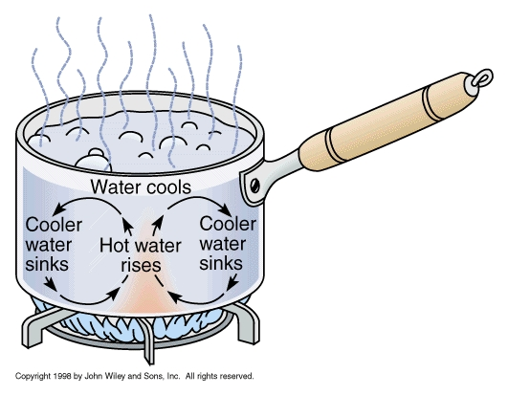
Which Form of Heat Transfer?

Slide 14
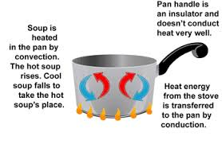
Answer

Slide 15
Website for further learning
http://www.wisc-online.com/Objects/ViewObject.aspx?ID=sce304

Slide 16
Heat Transfer Worksheet
Fill in the blanks or label the diagram with one of
Conduction
Convection
Radiation

Slide 17
Heat Transfer ws. ANSWERS

